Slide 1
Nervous System
A)Neurology – study of nervous system
B) neurons – conducting cells of the nervous system, normally do not divide (non-mitotic)
C) neuroglia – supporting cells of the nervous system, mitotic, numerous
D) nerve – bundle of axons
E) glioma – tumor caused by neuroglia cells
Notes:
I. Neurology – study of nervous system
a) neurons – conducting cells of the nervous system
b) neuroglia – supporting cells of the nervous system
c) nerve – bundle of axons
II. Nervous systems
a) Central Nervous System (CNS)- consists of brain and spine
b) Peripheral Nervous System (PNS)- outside of brain an spine

Slide 2
Nervous systems
Central Nervous System (CNS)- consists of brain and spine
Peripheral Nervous System (PNS)- outside of brain and spine

Slide 3
Afferent division
sensory - conducts impulses from receptors to CNS
Efferent division
motor - conducts impulses from CNS to effectors

Slide 4
somatic division
voluntary - from CNS to skeletal muscles
autonomic divisions
involuntary- from CNS to cardiac muscle,
smooth muscle, and glands

Slide 5
sympathetic division
like an “accelerator”
(elevate heart rate/constrict vessels)
parasympathetic division
like the “brakes”
(slow heart / dilate vessels)

Slide 6
Neuron anatomy
A) Soma – cell body
B) Dendrite(s)- carries impulse to soma
C) Axon – carries impulse away from soma
D) axon hillock – where an axon joins a soma
E) axon collateral – a branch off of the main axon
F) axon terminal – found at the end of each axon and axon collateral
G) synapse – space between neurons
H) synaptic end bulb – at axon terminal, stores neurotransmitter
I) axoplasm – cytoplasm in axon

Slide 7
Types of neurons
A) Multipolar - many dendrites, one axon
- most common type,
- major neuron type of CNS
B) Bipolar – one dendrite, one axon
- Rare
- found in some sensory pathways (retina, olfactory epithelium)
C) Unipolar – receptive endings at the end of one axon
- major neuron type of PNS
*How do you tell which nervous system a neuron belongs to???????

Slide 8
Neuroglia
A) CNS neuroglia
1. microglia – phagocytosis
2. ependymal cells- secrete, circulate cerebrospinal fluid (CSF)
3. astrocytes – form blood/brain barrier
4. oligodendrocytes – form myelin sheath on CNS axons, cannot repair*

Slide 9
B) PNS neuroglia
1. satellite cells- surround, protect clusters of somas (ganglia)
2. Schwann cells- form myelin sheath on PNS axons, can often repair*

Slide 10
Action potential (AP)– electrical signal (current) propagated along a membrane of a neuron’s axon
AP is characterized by a rapid change in membrane potential
An “all or nothing” event (always the same size current) which travels in one direction

Slide 11
Phases of action potential
Resting potential
-maintained by sodium potassium pumps
-measured with a value of (-70 mv) inside of the axon membrane (70 mv less than the outside)

Slide 12
Depolarization
- Na+ influx
- inside of axon moves to +30mv

Slide 13
Repolarization
- K+ outflow
- inside of axon moves to -90mv (undershoot)

Slide 14
Saltatory vs Continuous conduction
A) Saltatory conduction – fastest conduction, requires fully myelinated axons
- action potential leaps from Node of Ranvier to Node of Ranvier
B) Continuous conduction – slowest, axons that are not fully myelinated
- action potential travels entire length of axon

Slide 15
Conduction across a synapse
1. Action potential reaches axon terminal of presynaptic neuron
2. Calcium channels open in axon terminal membrane
3. Calcium influx favors release of neurotransmitter from synaptic vesicle
4. Neurotransmitter diffuses across synapse
5. Neurotransmitter binds to postsynaptic neuron
6. This binding will either open sodium or potassium channels
7. neurotransmitters have only a brief effect. Why?
a)destroyed by enzymes
b)diffuse away from synapse
c) uptake by cells (astrocytes)
* why is this a good thing?

Slide 16
Action potentials vs. graded potentials
A) action potentials one size, all or nothing -------carried long distances (axons)
B) Graded potentials- vary in size,
- Carried over short distances (dendrites, somas)
-have a summation effect at the axon hillock

Slide 17
IPSP vs EPSP
A) IPSP (inhibitory post-synaptic potential)
- caused by an inhibitory neurotransmitter
- K+ channels open, K+ outflow
- voltage inside of membrane decreases further from threshold at hillock
-72mv, -75mv
B) EPSP (excitatory post-synaptic potential)
- caused by an excitatory neurotransmitter
- Na+ channels open, Na+ influx
- voltage inside membrane increases, closer to threshold at hillock
-69mv, -60mv

Slide 18
Agonist vs Antagonist
A) an agonist favors the actions of a neurotransmitter How?
1. keep neurotransmitter in synapse longer
2. mimic existing neurotransmitter(s)
B) an antagonist blocks the effects of a neurotransmitter. How?
1. prevent its release (presynaptic effect)
2. prevent its binding (post-synaptic effect)

Slide 19
Fibers=axons
A) A fibers – thickest , fastest axons – fully myelinated
- somatic sensory/motor functions
- 300 mph!
B) B fibers – intermediate thickness, intermediate speed – fully myelinated
- autonomic motor, sensory(visceral, pain, small touch)
- 40 mph
C) C fibers- thinnest, slowest axons – not fully myelinated (unmyelinated)
-autonomic motor, sensory (visceral, pain, small touch)
- 2 mph

Slide 20
What is a NERVE?
A bundle of axons traveling to/from a particular body location.

Slide 21
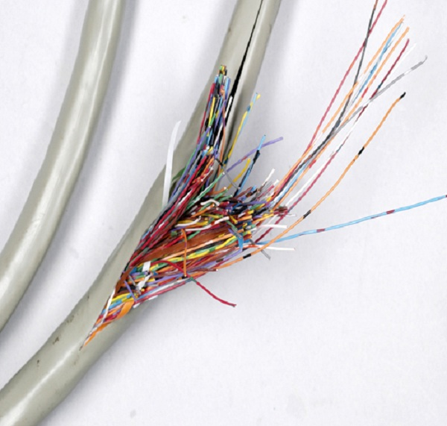

Slide 22
Final Content terms/concepts
A) local anesthetics – block Na+ channels.
B) Multiple Sclerosis – (MS)- immune system attack of myelin
C) Excitotoxicity – ischemia causes glutamate to linger in synapse
- stimulates neurons to death
D) Tetanus (Clostridium tetani) toxin carried by fast axonal transport to CNS

Slide 23
Generation of action potential
a) at rest, Na/K pumps maintain a -70mv resting potential. How?
b) a stimulus is received
c) some Na channels open, Na influx
d) at threshold, many Na channels open, massive influx
e) inner membrane potential reaches +30mv
f) Na channels close, K channels open
g) K+ outflow
h) inner membrane potential reaches -90mv (undershoot)
i) K+ channels close
j) Na/K pumps restore -70mv resting potential

Slide 24
A graph of action potential
.
A) values
-70mv → resting potential
-55mv → threshold
+30mv → result of total Na+ influx
→ where Na+ gates close/K+ gates open
-90mv → undershoot
B) refractory periods
1) absolute – surrounds peak
-no other action potential can occur
2) relative – surrounds undershoot
-another action potential can occur only with a strong stimulus. Why?

