Slide 1
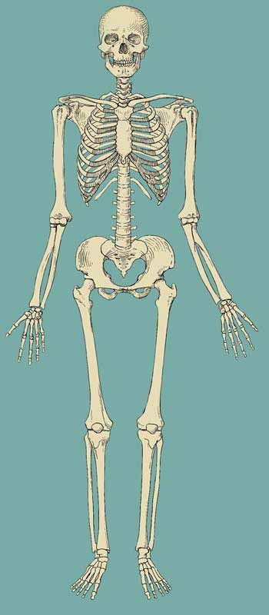
Anatomy & Physiology Introduction
Anatomy -(dissect) study structure
Physiology -function
bilateral symmetry – right/left division based on anatomical position

Slide 2
Levels of organization
atoms →molecules→*cells*→tissues →organs→systems→organism

Slide 3
Body location terminology
a) ventral (anterior) vs dorsal(posterior)
front vs back
b) superior vs inferior
above vs below
c) ipsilateral vs contralateral
same side vs opposite sides
d) lateral vs medial
away from midline vs closest to midline

Slide 4
e) axial vs appendicular
head/trunk vs limbs
f) superficial vs deep
closest to surface(skin) vs internal
g) distal vs proximal
far vs near

Slide 5
Planes through the body (cuts)
a)coronal / frontal
separation of ventral from dorsal
b)sagittal / midsagittal
separation of right from left
c)transverse / oblique
separation of superior from inferior

Slide 6
Body cavities
A) Dorsal cavities
1) cranial - contains brain
2) spinal - contains spinal cord

Slide 7
B) Ventral cavities
1) thoracic - entire chest cavity
a) mediastinum (1)
heart, trachea, esophagus, thymus
b) pleural (2)
one lung in each pleural cavity

Slide 8
2) abdominal
*below the diaphragm to pelvic
liver, stomach, spleen, pancreas,
most of the intestine, kidneys,
3) Pelvic
gonads, bladder, urethra

Slide 9
C) Assorted body cavities
1) nasal -behind nose
2) oral/buccal – mouth
3) middle ear – ear canal, hammer,
anvil, stirrup, tympanic membrane
4) orbital - eye
5) synovial - bone joint

Slide 10
Tissues
Tissue – group of cells and their products with
common origin and function
Histology – study of tissues
Biopsy – surgical removal of tissue sample
Pathologist – analyzes tissues for disease

Slide 11
Four tissue types
A) Epithelial – lines surfaces, forms glands
B) Connective – binds, supports
C) Muscle – movement, heat,
D) Nervous – communication

Slide 12
Epithelial Tissue
Naming
A) layers
1) simple
2) stratified
3) pseudostratified
B) cell shape
1) squamous
2) cuboidal
3) columnar
4) transitional

Slide 13
Characteristics
- minimal matrix
- avascular
- nerve supply
-underlying basement membrane
-lines surfaces EVERYWHERE

Slide 14
Epithelial – component of glands
Classification
A) Endocrine - secrete hormones into blood
- ductless
B) Exocrine – secrete product into duct

Slide 15
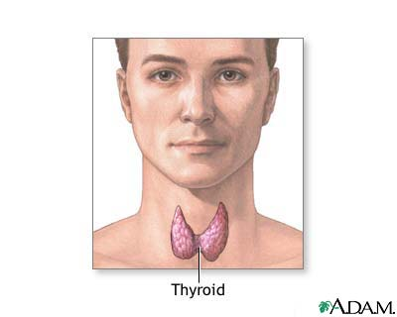
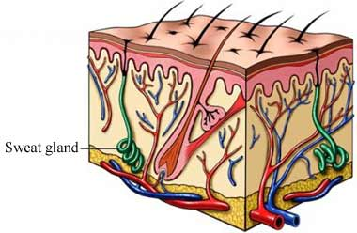
2 types of glands
endocrine
exocrine

Slide 16
Connective Tissue
Characteristics
a) abundant matrix
b) mostly vascular
c) nerve supply
d) deep

Slide 17
Examples:
1) areolar – “glue”
2) adipose – fat
3) reticular – web-like
4) dense regular – rope-like
5) dense irregular – sheet-like
6) elastic – stretchy, resilient
7) Bone
8) Cartilage
9) Blood
10) lymph

Slide 18
Cell junctions
Based on membrane protein interactions
A) tight junction – prevents leakage
- GI tract
B) gap junction – rapid communication
- heart
C) desmosome – prevents separation
- skin

Slide 19
Membranes
Epithelial + connective
A) mucous – lines passageways to exterior
B) serous – lines organ(s) in cavity
C) synovial – surrounds bone joints
D) cutaneous - skin

